Slide 1
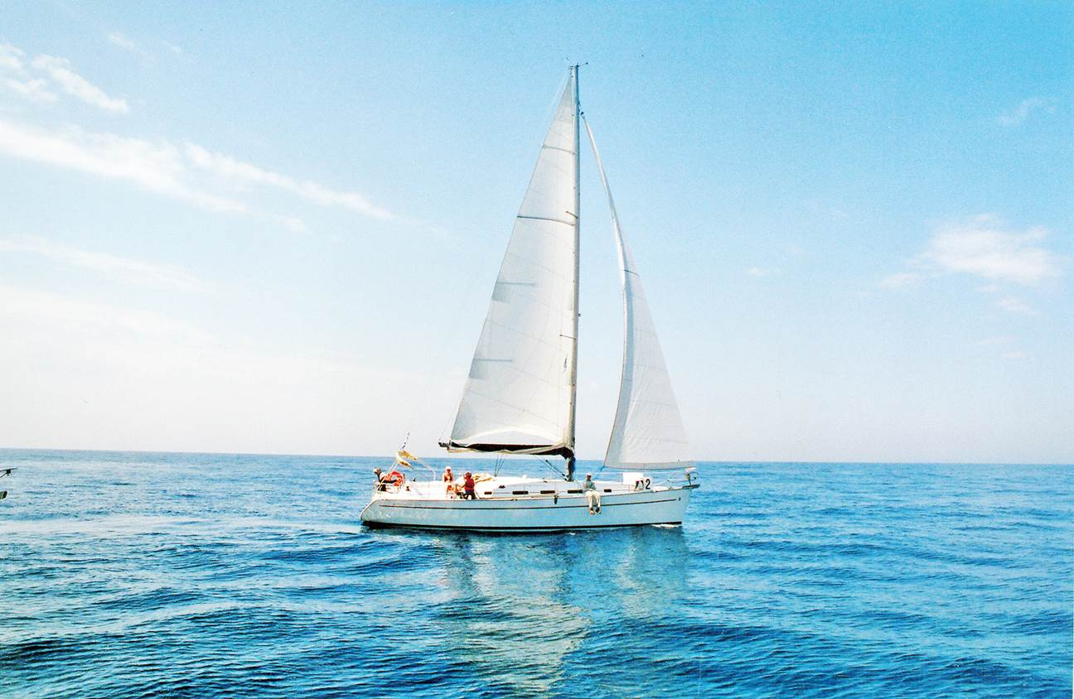
Guess the word
Large
Luxury
On board
Crew
Port
sail
boat
Yacht

Slide 2
YACHT FOUND DESERTED
What happened to the people on board the boat?
We/I think they probably…
Perhaps they…
Maybe…

Slide 3
Read the words, their meanings and translate
Yacht - a large boat with sails used for pleasure or in races
Luxury – great comfort/pleasure from expensive things
Crew - the people who work together on a ship, aircraft, or train
Weird – very strange
Doubt – not certain or trusting
Likely – probable
Sign - something that shows that something is happening
Speculate - to guess possible answers to a question when you do not have enough information to be certain

Slide 4
Learn this!
We use must have+V3 to say we are sure that something happened, even if we don’t have definite information or proof that it happened.
We use can’t have+V3 to say we strongly believe that something didn’t happen.
We use might, could or may have +V3 when we are less certain that something happened

Slide 5
Speculating about the past modal verb +have + V3 (Past participle)
Could have a. it’s didn’t happen
Might have b. maybe it happened
Must have c. it happened
Can’t have

Slide 6
Paraphrase the sentences using must have, could/might have or can’t have
1. It’s possible that Rosie went out. She’s got flue. Rosie can’t have gone out .
2. It was definitely Jake’s birthday yesterday. He had a big party and a cake.
It _must have been Jake’s birthday yesterday .
3. It’s possible that we made a mistake. We’ve never done this before.
We ___could/might have made a mistake
4. it’s impossible that you saw a ghost. They don’t exist.
You __can’t have seen a ghost.
5. Oh, no! I forgot my keys. They aren’t in my bag. I__
I must have forgotten my keys.
6. it’s impossible that they got lost. They have got a map. They __
They can’t have got lost

Slide 7
the words can help you
Set fire deliberately
Have an argument
Be furious
Unconscious
Unlikely
Good sense of direction
By accident
Instead

Slide 8
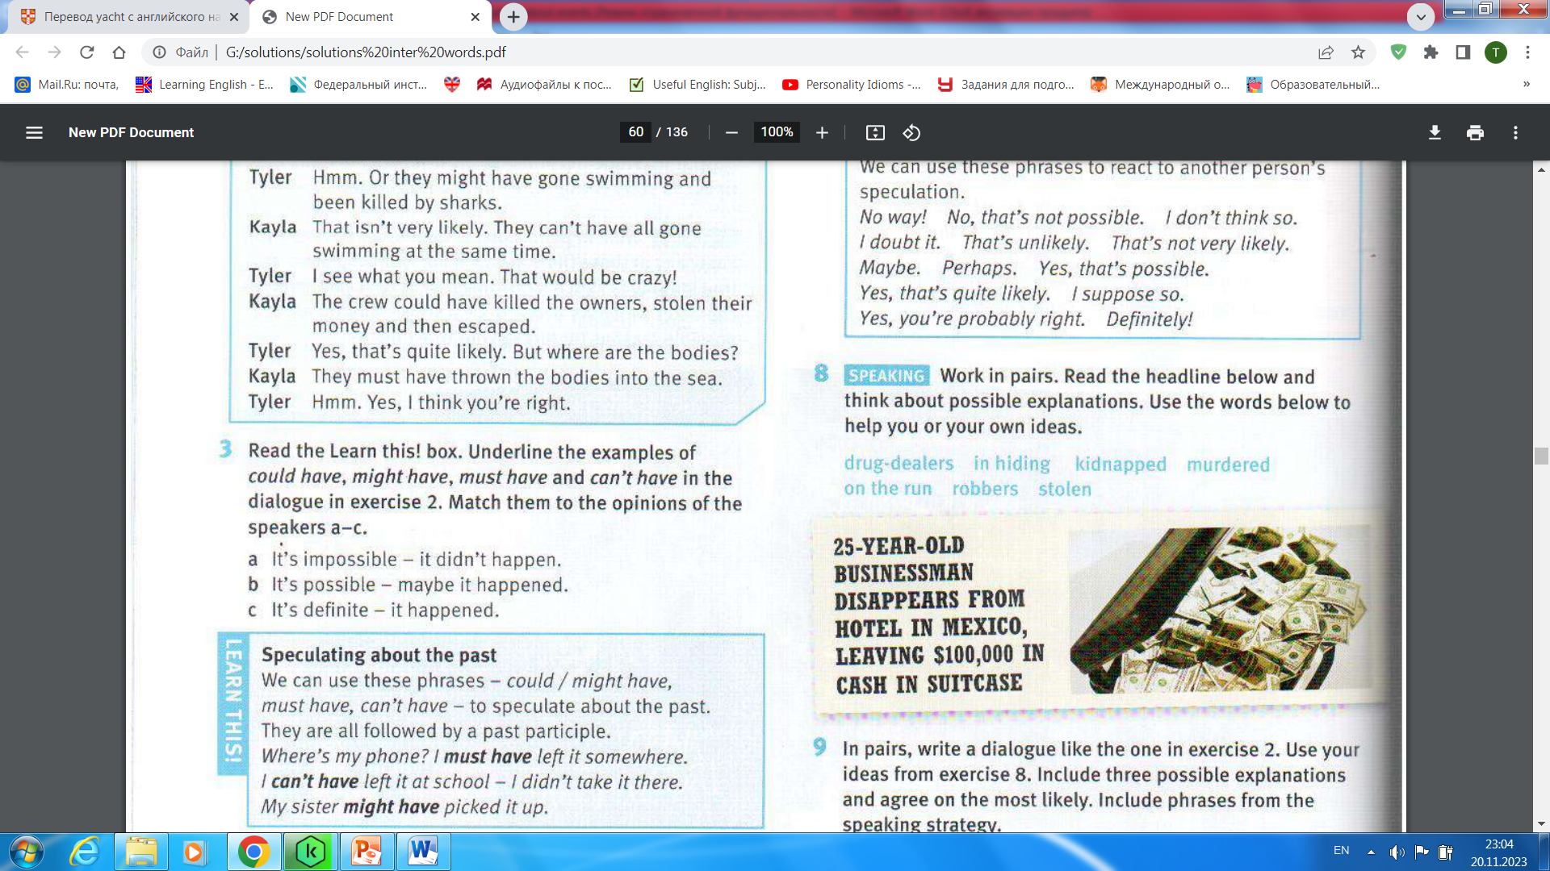
h/w ex. 8-10
Write a dialogue like the one in ex.2. Include three possible explanations and agree on the most likely. Include phrases from the speaking strategy.
Act out the dialogue

